Slide 1
Insure Audio Deepfake
Aidan Gow, Dan Sutter, Sagnik Dakshit, Mohan Reddy, Nihil Patel, Vishnu Kunadharaju

Slide 2
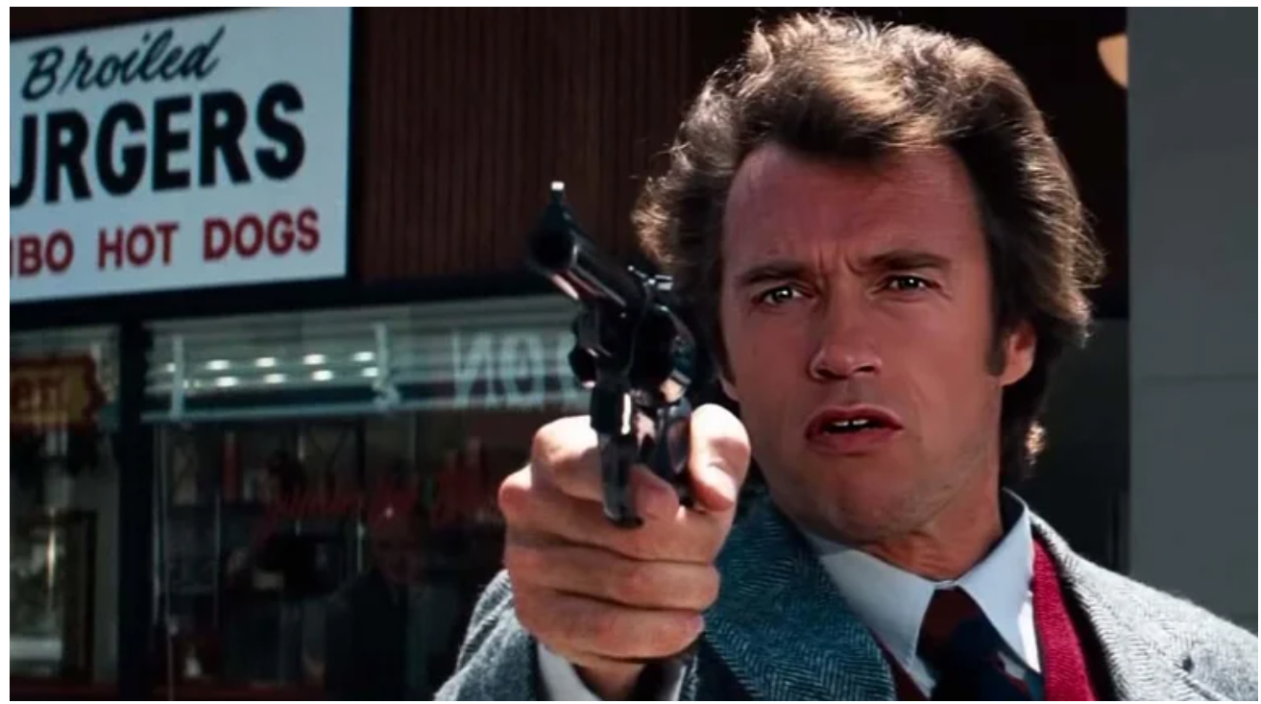
Introduction to Deepfakes
‘Deepfakes’ are fake media, created from deep learning algorithms. One example is to realistically swap faces and audio from authentic video and digital content.
Notes:
Technology is currently growing and improving at an exponential, almost uncontrollable rate. One of the byproducts of such advancements are ‘Deepfake’ audio/video files. Before delving any further, I want to provide a brief overview of what a deepfake is. ‘Deepfakes’ are fake media content, created from deep learning algorithms. One example is a realistic swap of faces and/or audio from authentic video and digital content. The term Deep learning, in that statement, refers to a set of algorithms that are capable of teaching themselves to solve a problem given a large enough dataset. To provide a better sense of what I am discussing, here we have a image from a deepfaked video where the algorithms have realistically swapped out the face of the actor Clint Eastwood with the Arnold Schwarzenegger from the movie Dirty Harry.

Slide 3
Motivation
Widespread availability of high quality deepfake generation tools
  15.ai
  thispersondoesnotexist
Malicious actors can use existing tools to create misleading images, videos, and audio clips
Generative adversarial networks (GANs) can refine and improve deepfaked content to look highly realistic.
Notes:
At first deepfakes can seem harmless, however, upon closer examination they can pose a grave danger to society at large. To understand the reasoning behind this claim lets review the facts at hand. Currently, there are a wide array of tools that are accessible to the public. So anyone can get their hands on such tools and create their own deep fakes (free, publicly available examples: 15.ai which can generate voices of characters from video games, and thispersondoesnotexist.com which generates fake human faces). The issue arises when malicious actors use the existing tools at hand to create misleading images, videos, and audio clips. An example to consider is the dangers of a shared video wherein politicians give completely fake speeches, or a real written speech that was never actually given (example: the Nixon speech prepared for if the moon landing failed). As deepfake technology becomes more readily available to the public, it will be easier to spread this fake content at a much faster rate. With the proliferation of such media, it will be increasingly difficult for citizens to be accurately informed on critical issues in their country. Not only that, deep learning algorithms can be leveraged to refine and improve existing deepfake content to look more realistic through each progressive iteration. At some point, a normal viewer may be unable to discern if the content they’re looking at is synthetic or genuine.

Slide 4
Problem Statement
Sponsors: John Hopkins Applied Physics Lab (Timothy Davison).
Develop a Deep Learning model that can accurately identify synthetic (deepfaked) audio.
Final Challenge: Roadrunner Documentary
Notes:
The goal of our project seeks to provide a solution to address this rising issue in audio deep fakes specifically. This project was put forth by the John Hopkins Applied Physics Lab with Timothy Davison acting as the main sponsor. Our teams approach is to see if we can develop a machine learning model that accurately classify if a piece of audio is genuine or synthetic (created through deepfake technology). The final challenge, which will occur at the end of the semester, will culminate in a real-world exercise in which audio clips published in the recent Anthony Bourdain documentary ‘Roadrunner’ - clips which the filmmakers claim to be indiscernible as real or fake - will be tested by our machine learning model.

Slide 5
Literature Review
Common approach so far is to convert audio signals to spectrograms for training 2D deep learning classifiers.
The 2D convolutional neural networks (CNN) based approaches have achieved over 95% accuracy in spoof detection using transfer learning.
Ensemble of methods using both raw waveforms and 2D spectrograms have lead to superior performance rather than relying solely on spectrograms.
Notes:
Prior to embarking on our project, our first steps were to examine the existing research papers detailing previous attempts at solving this issue. Upon completion of the literature review, it was discovered that the most common approach to detecting audio deep fakes were to convert audio signals into the frequency domain of spectrograms for 2D deep learning classifiers. Using spectrograms to train a 2D convolution neural network has achieved over a 95 percent accuracy in spoof detection with the use of transfer learning. Despite the 2D CNN based approach yielding a high accuracy score, it was later revealed that using a ensemble of methods (deep learning models and traditional machine learning models) that were trained on using raw signals and spectrograms respectively has resulted in a much more powerful classifier.

Slide 6
Our Approach
Deep Learning Classification Models
Different Modalities of data
  Signals, Spectrograms, LFCC
Investigate the effect of different Activation functions.
  Relu, Tanh, LRelu
Develop an Ensemble for state-of-the-art generalized performance
Notes:
Based on our sponsor’s recommendation, we decided to utilize data from the ASVSpoof challenges to train our machine learning models. ASVSpoof is the Automatic Speaker Verification Spoofing and Countermeasures Challenge. It is a bi-annual, competitive challenge where the goal is to develop countermeasures capable of discriminating between bonafide and spoofed or deepfake speech. We have two data sets to work with currently, from the 2019 and 2021 challenges. The 2019 dataset has one bonafide label and six AI labels. The bonafide label means the audio was human generated, but the other 6 labels represent different AI generation methods to create the synthetic audio. The ASVSpoof 2021 dataset has no labels present, but it has the results for evaluation.

Slide 7
The Data
ASVSpoof 2019
  Split into Train (8 male, 12 female), Dev (4 male, 6 female) and Eval (21 male, 27 female)
  Each set has audio signals in FLAC format and corresponding labels
  1 Bonafide (Human) label and 6 AI labels (spoof)
ASVSpoof 2021
  Only for results evaluation
  No labels
Notes:
Based on our sponsor’s recommendation, we decided to utilize data from the ASVSpoof challenges to train our machine learning models. ASVSpoof is the Automatic Speaker Verification Spoofing and Countermeasures Challenge. It is a bi-annual, competitive challenge where the goal is to develop countermeasures capable of discriminating between bonafide and spoofed or deepfake speech. We have two data sets to work with currently, from the 2019 and 2021 challenges. The 2019 dataset has one bonafide label and six AI labels. The bonafide label means the audio was human generated, but the other 6 labels represent different AI generation methods to create the synthetic audio. The ASVSpoof 2021 dataset has no labels present, but it has the results for evaluation.

Slide 8
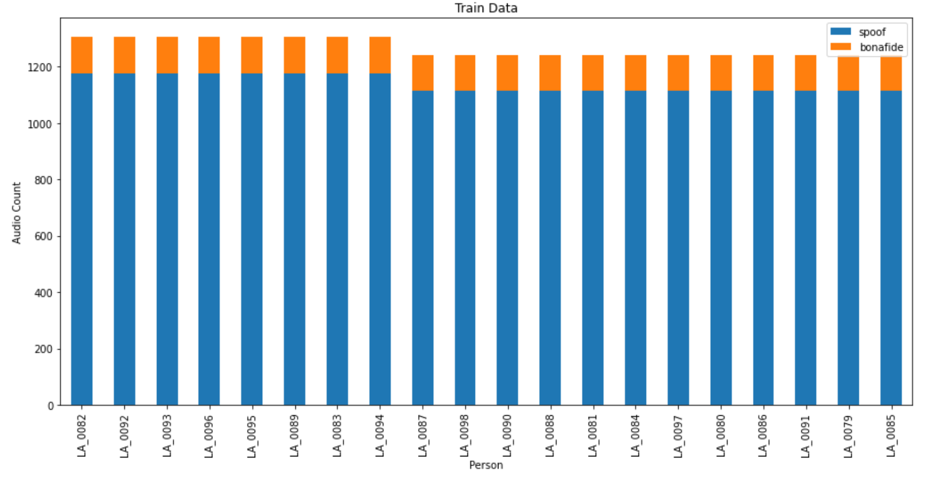
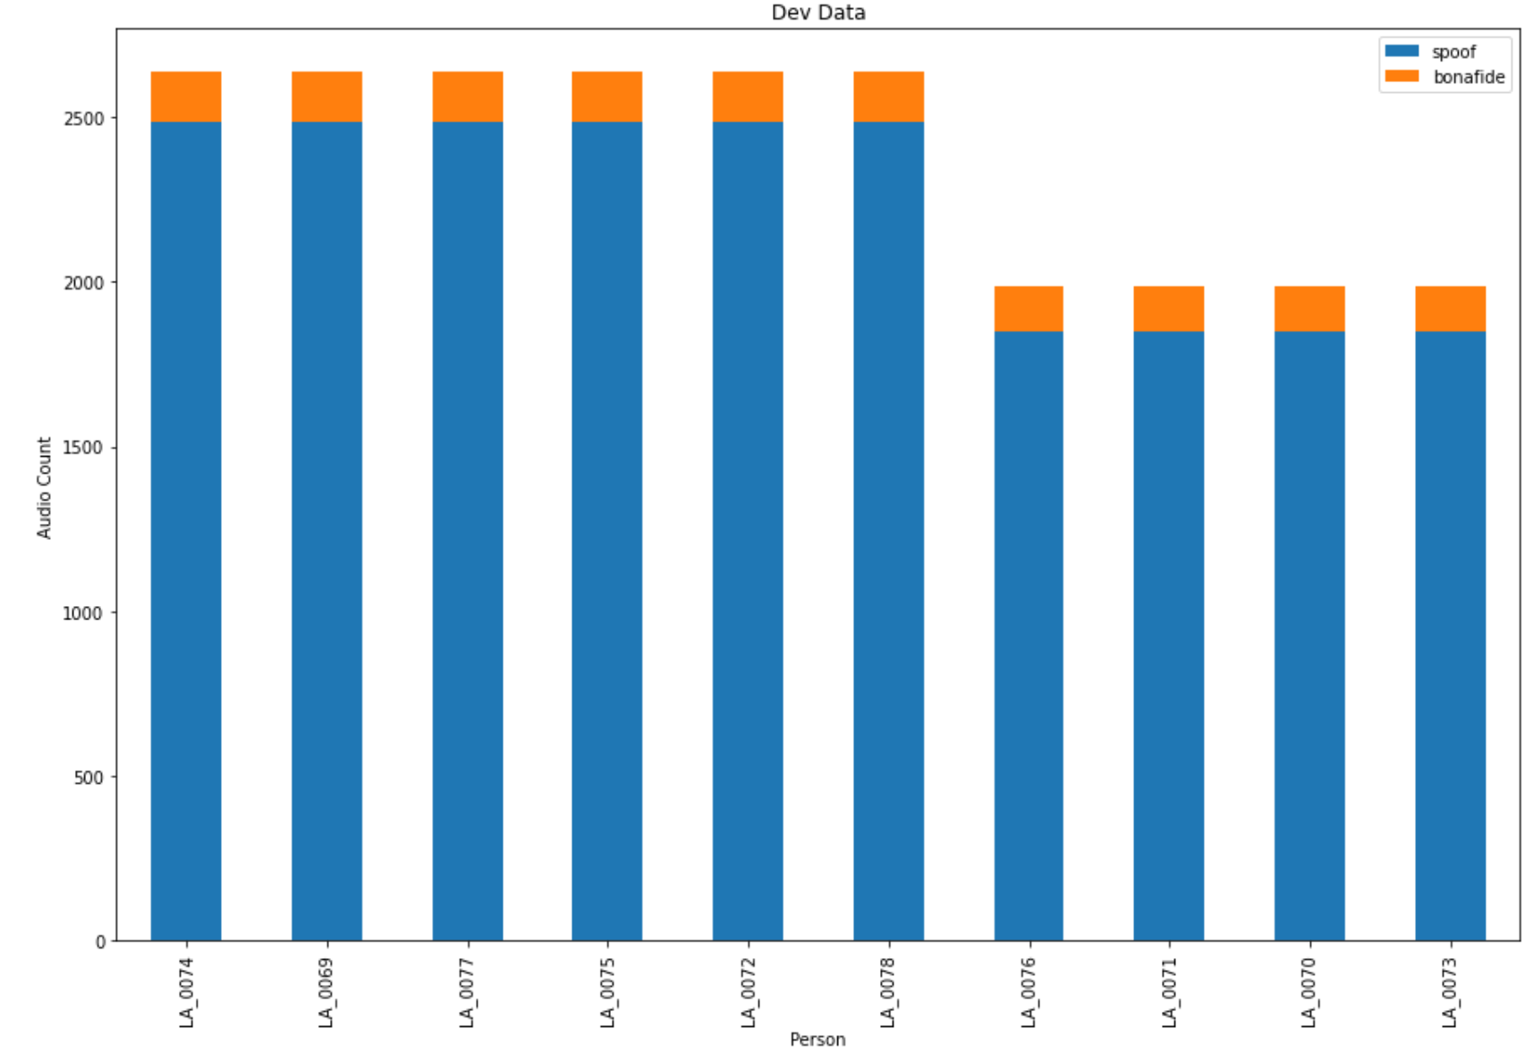
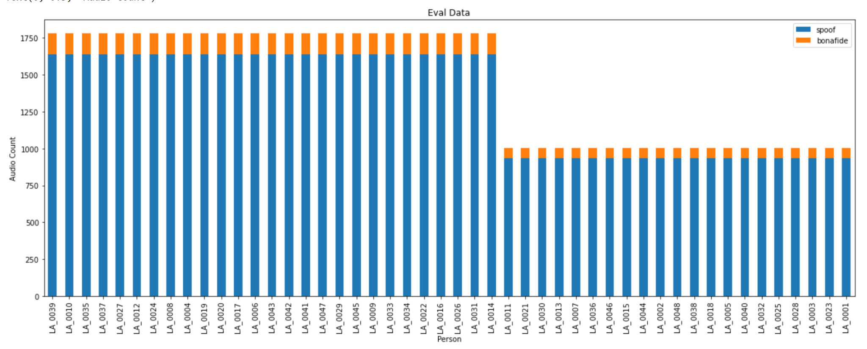
Data Distribution
Notes:
As we can see the 2019 dataset has 3 components : train, dev, eval and each group has audio files from different group of people. These are h plots for the dat distribution between different speakers and their Soof or generated audio signals

Slide 9
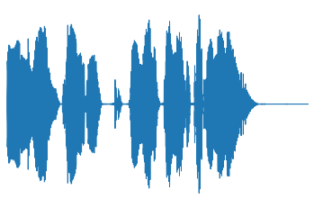
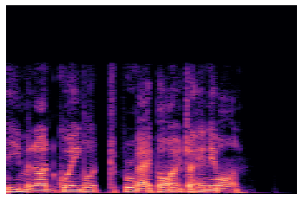
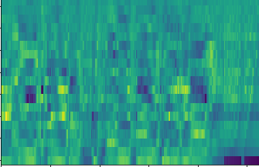
Data Modalities
Signal Waveform
Spectrograms
LFCC
Notes:
These are some of the modalities we have derived for an audio flac file from the dataset. The first is the plot of the raw signal waveform and the next is the spectrogram while the last one is the LFCC which is the latest one we are trying

Slide 10
Challenges
Long time for data conversion type and model training
  Trying to express the audio in various forms
  Exploring parallel processing libraries like numba and using jit, cuda.jit
Misleading accuray due to unbalanced labels
  Trying to use multi label classification
  Using other accuracy metrics
Decisions on data pre-processing
  To remove noise or not? For now no, but will do so in future for result comparison to prove noise removal actually decreases accuracy
  Which representation of audio signals to use among the available (BFCC, LFCC, LPC, LPCC, MFCC, IMFCC, MSRCC, NGCC, PNCC, PSRCC, PLP, RPLP, Frequency-stats)? For now Spectrograms and LFCC but based on results, might shift to others like Raw Waveforms, MFCC, Mel Spectrograms
Notes:
Class imbalance:
2000 bonafide but you have 28,000 AI labels

Slide 11
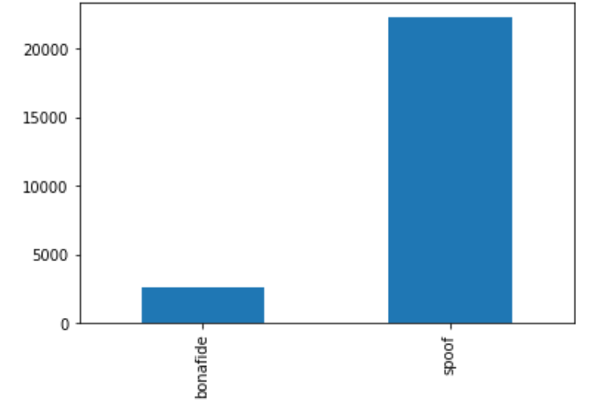
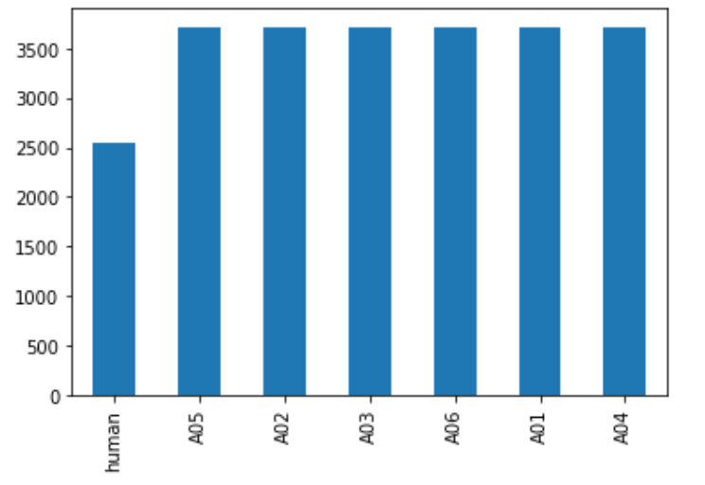
Limitation of Current Results
Imbalance dataset leading to poor classification metrics
Ex: Spoof: 22296(+), Bonafide: 2548(-)
  Classification System Result: Spoof: 22286(TP), Bonafide: 10 (TN), FP: 2538, FN: 10 Accuracy: 89.7% Accurate, 10.3% error
  Precision: 89.8%, Recall: 99.9%, F1 Score: 94.5
Lack of Transfer Learning models for 1D CNN model.
  Unlike 2D CNN models such as ResNet, InceptionNet, 1D pretrained models are not available
Notes:
Class imbalance:
2000 bonafide but you have 28,000 AI labels

Slide 12
Next Steps
Generating the LFCCs for the train
Process and Create Balanced Dataset
Training the data with appropriate metrics:
  Transfer Learn on 2D CNN ResNet, InceptionNet
  Train custom 1D CNN architecture from scratch
Result Comparison
  With and without background noise
  Between the various modalities
  Between the trained DL architectures

Slide 13
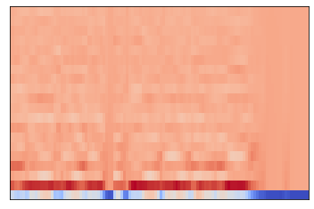
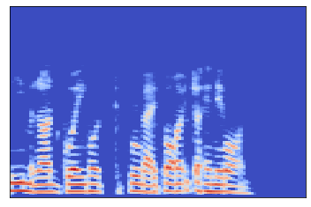
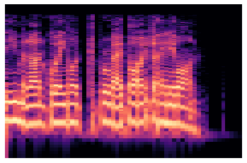
Future Data Modality Considerations
MFCC
MEL Spectograms
Spectograms (LogScale)

Slide 14
Questions, Suggestions, Feedback

